Slide 1

DP-201T02: Azure Batch Processing Reference Architectures

Slide 2
Lesson Objectives
Lambda architectures from a batch mode perspective
Design an enterprise business intelligence solution
Automate an enterprise business intelligence solution
Architect an enterprise conversational bot

Slide 3
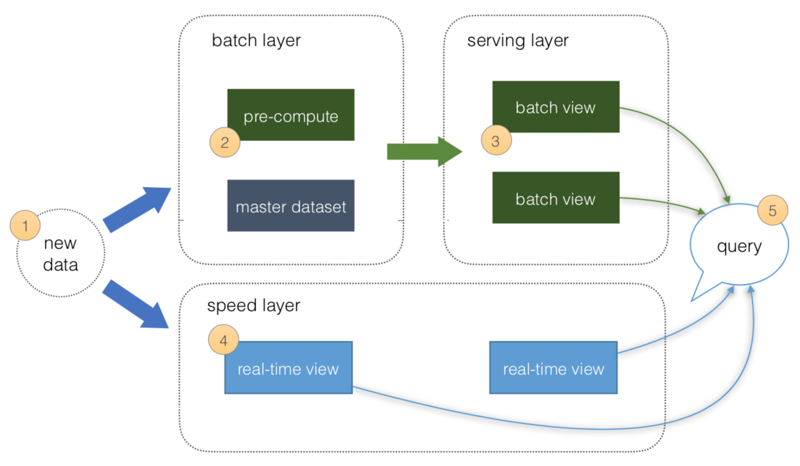
Lambda architectures from a batch mode perspective
Batch Layer
The Batch layer is used to pre-compute results on large volumes of data using a distributed data system.
New data ingested from sources
Data is precomputed
Serving Layer
The serving layer acts as the storage output of either the Batch or Speed layer that is used by client applications to access the results of the data-sets.
3. Batch views can be used as precomputed views
Notes:
The Lambda architecture sets out a framework for data processing from both a speed and batch mode perspective.
The Batch layer is used to pre-compute results on large volumes of data using a distributed data system.
As this data is not being processed in real-time, the objective is to ensure that the results computed are
as accurate as possible and updated on a regular schedule.
This gives the opportunity to fix any errors before presenting a computed dataset, or recompute the data-set based on a refresh of the data
The serving layer acts as the storage output of either the Batch or Speed layer that is used by client
applications to access the results of the data-sets.
This enable ad-hoc queries to be issued against the Serving layer without negatively impacting either the Batch or Speed layer.

Slide 4
Lambda Architecture
Batch layer (cold path)
Stores all the incoming data in its raw form and performs batch processing on the data.
The result of this processing is stored as a batch view.
Data is not subject to low latency requirements.
Allows for high accuracy computation across large data sets, which can be very time intensive
Speed layer (hot path)
Analyzes data in real time.
This layer is designed for low latency, at the expense of accuracy.
The batch layer feeds into a serving layer that indexes the batch view for efficient querying.
The speed layer updates the serving layer with incremental updates based on the most recent data.

Slide 5
Lambda architectures
Eventually, the hot and cold paths converge at the analytics client application.
The hot path has data for a relatively small window of time.
The raw data stored at the batch layer is immutable.
Incoming data is always appended to the existing data, and the previous data is never overwritten.
Any changes to the value of a particular datum are stored as a new timestamped event record.
This allows for recomputation at any point in time across the history of the data collected.
The ability to recompute the batch view from the original raw data is important, because it allows for new views to be created as the system evolves.
This is key for training machine learning models.

Slide 6
Azure Technologies for Lambda Architecture
Batch Layer
Azure Databricks
Azure SQL Database
Azure Synapse Analytics
Azure Cosmos DB
Azure Data Lake Storage Gen II
HDInsight
Serving Layer
Azure Analysis Services
Power BI

Slide 7
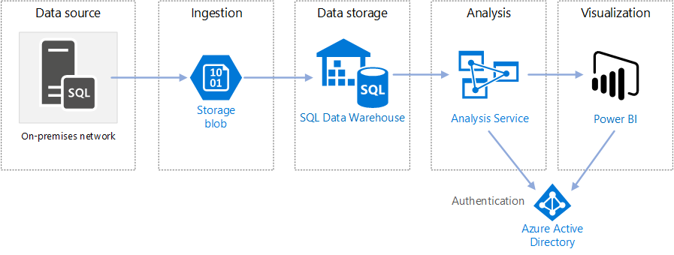


Design an Enterprise Business Intelligence Architecture
Semantic Layer
Staging Area
Polybase
Notes:
Azure Blob Storage is used as an intermediate staging area for the the OLTP data from the on-premises
SQL Server.
Important: You can replace the staging area with Azure Data Lake Storage Gen II that can act as a raw
data source store for Azure Databricks and HDInsight as well as Azure Synapse Analytics

Slide 8
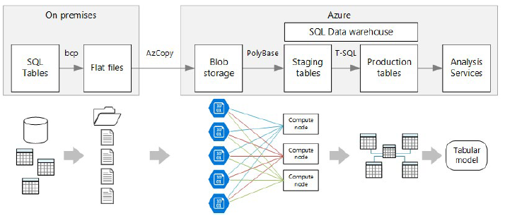
Data Transfer
Notes:
The best approach would be to use Bulk Copy Program (bcp) to transfer the data from SQL Server into
flat files in folders and then use AZCopy to transfer the data to Azure Blob Store.
You can then use PolyBase to perform a parallelized data load into staging tables in Azure Synapse Analytics, using Transact-SQL to transform the data into the final data warehouse tables.
Use Analysis Services to create a semantic model that users can query. Analysis Services is especially useful in a BI dashboard scenario. In this architecture, Analysis Services reads data from the data warehouse to process the semantic model, and efficiently serves dashboard queries. It also supports elastic concurrency, by scaling out replicas for faster query processing

Slide 9
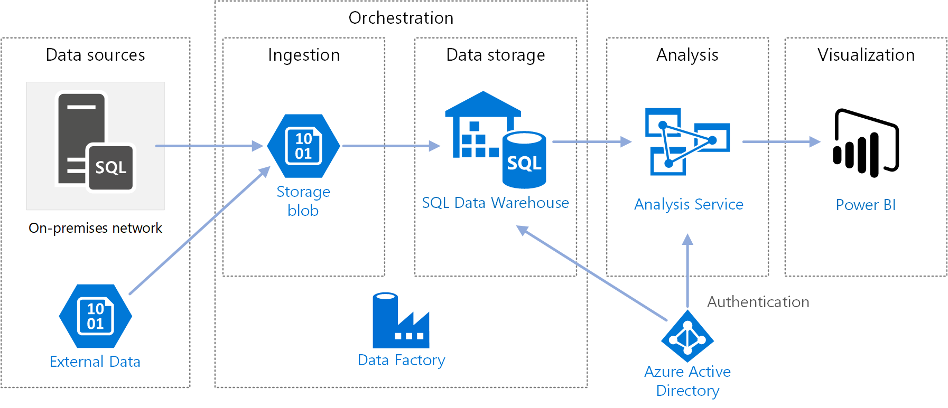
Automate an Enterprise Business Intelligence Architecture
Notes:
In this example, the data is located in an OLTP databases hosted on an on-premises SQL Server. In addition, there are additional data stores that are used to collect data from
This architecture expands on the previous solution by introducing automation to the data pipelines using Azure Data Factory. This enables an organization to perform incremental data loads into an Azure Synapse Analytics using an Extract, Load and Transform (ELT) pipeline.
This reference architecture defines a master pipeline that runs a sequence of child pipelines. Each child pipeline loads data into one or more data warehouse tables incrementally.

Slide 10
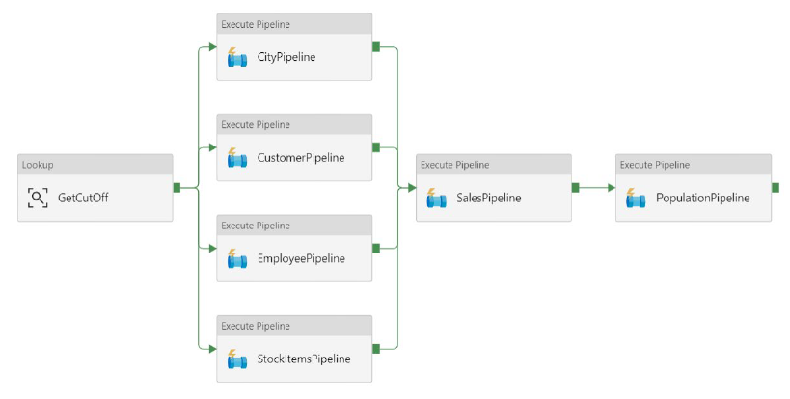
Master Pipeline
Notes:
To perform an incremental load, you need a way to identify which data has changed. The most common approach is to use a high water mark value, which means tracking the latest value of some column in the source table, either a datetime column or a unique integer column

Slide 11
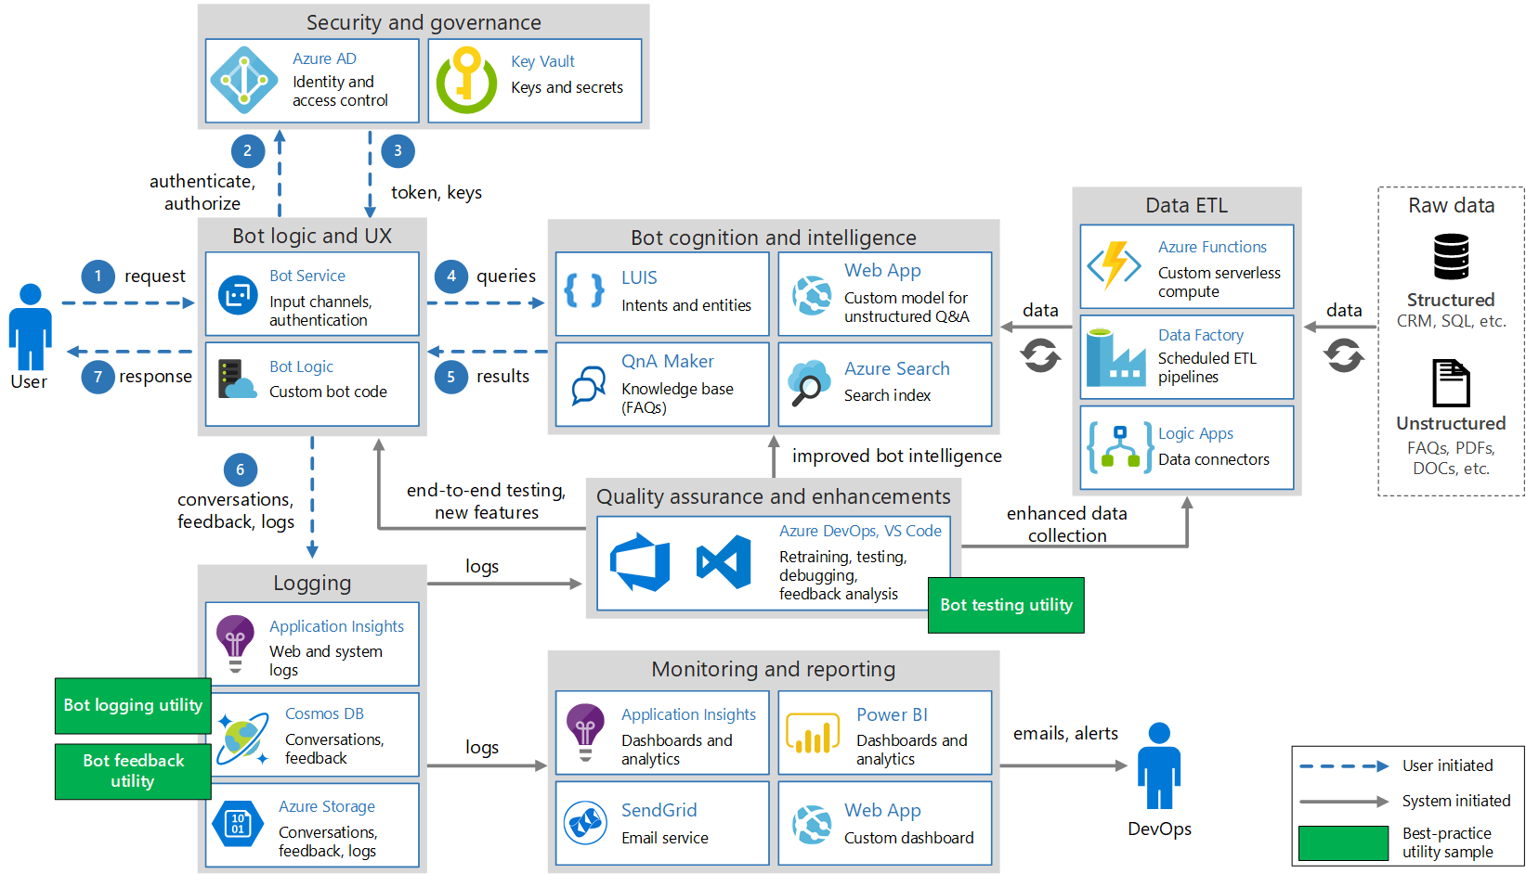
Architect an Enterprise Conversational Bot
Notes:
This architecture is complicated. But the majority of this architecture is for an AI Engineer to design and build.
we are interested in the data components that we may be asked to support the AI Engineer with. Namely:
Creating a data store to hold bot logging data. (See the Logging section of the architecture)
Creating a data store to hold Cognitive Services metadata. (See the Data ETL of the architecture)
Bot Logging Data
Typically data will be sent to a Cognitive Services API, which may return back data, sometimes in the form of metadata.
You can setup a Cosmos DB instance, and create middleware to store “entries” as users interact with the bot.
You can then use the capabilities of Cosmos DB to replicate this data globally if required.
If planetary scale is not required, the you can simply use Azure Blob Store/Data Lake Store Gen II should you wish to use this as a Machine Learning source of data for text analytics.
Cognitive Services Metadata
The data that is returned, will be Tag and Description data that is used to explain the content of an image.
You may want this data to be stored; in addition, you may also want to place an Azure Index on top of this data to speed up searches for the bot.

Slide 12
Review Questions
Q01 – Which sign aspect is concerned with ensuring the prevention of unauthorized data access?
A01 – Security design
Q02 – What is the definition of Shared Responsibility?
A02 – With Shared Responsibility, your cloud provider will manage certain aspects of your application, leaving you with the remaining responsibility.
Q03 - Which architecture design consideration could be used to help AdventureWorks scale globally?
A03 – Scalability design

Slide 13

Lab: Azure Batch Processing Reference Architectures

Slide 14
Lab overview
The students will use the case study to identify which business and technical requirements relate to a Lambda architecture from a batch mode perspective. The student will then architect an enterprise BI solution, and then add automation to the architecture. Finally, the students will attempt to design and AI architecture that focuses on the data stores that would be required to support such a solution.
Lab objectives
After completing this lab, you will be able to:
1. Design an Enterprise BI solution in Azure
2. Automate enterprise BI solutions in Azure
3. Architect an Enterprise-grade conversational bot in Azure

Slide 15
Lab scenario
You are the senior data engineer of AdventureWorks. You are designing and architecting a solution that will deal with the batch mode processing of data. You have been advised that the solution architecture should take a holistic view of all the business requirements and your proposal should be presented in a Word document.
You will first define which aspect of the AdventureWorks requirements fits into batch mode processing of a Lambda architecture. You will then provide an architecture for an enterprise BI solution in Azure and think of ways that the solution can be automated. You will also design a first pass on an AI architecture.
At the end of this lab, you will have:
1. Design an Enterprise BI solution in Azure
2. Automate enterprise BI solutions in Azure
3. Architect an Enterprise-grade conversational bot in Azure

Slide 16
Lab review
Exercise 1 – Review the architectures
Exercise 2 – Are there any differences in architectures between groups?
Exercise 3 – How does the holistic architecture for batch mode processing look?

Slide 17
Lab review
Exercise 1 - Task 1: Design an Enterprise BI solution in Azure - Requirements
# | Requirement | Technology Suggestion
1 | Performing historical reporting and descriptive analytics (Task 2) | Azure Synapse
2 | Performing predictive analytics with historical data (Task 2) | Azure Databricks
3 | Connected bicycle daily summary data storage – Telemetry – Event Hub (Task 2) | Azure Data Lake Store Gen II
4 | Respond to requests for data in near real-time regardless of where the customer is located. (Lab 03) | Azure Cosmos DB

Slide 18
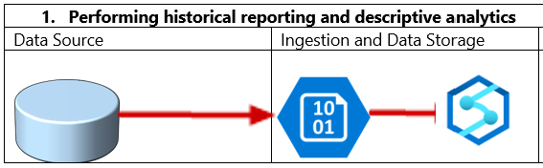
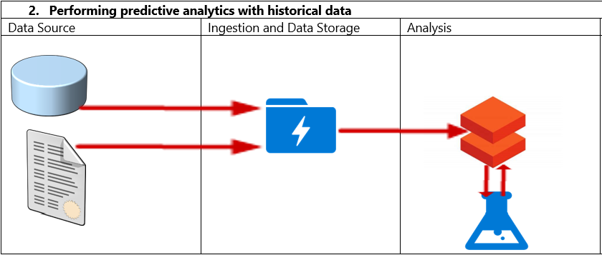
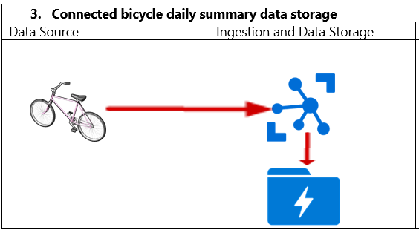
Lab review
Exercise 1 - Task 2: Build a high-level Architecture that reflects the Enterprise BI solution in Adv. Works

Slide 19
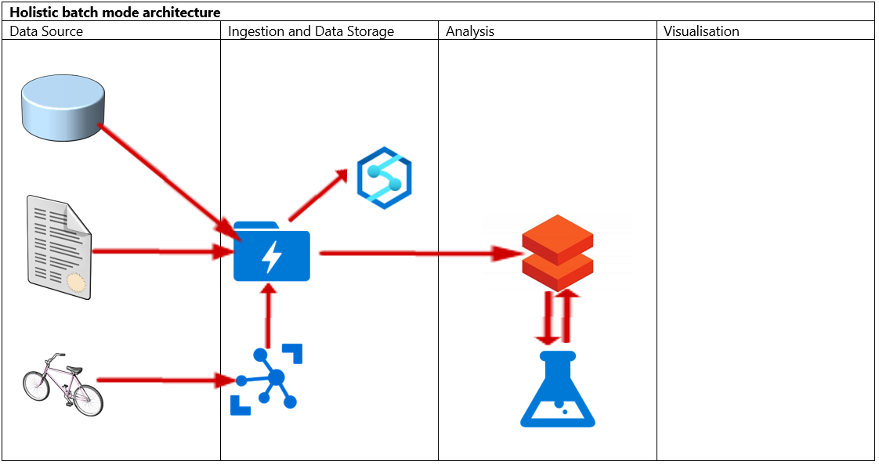
Lab review
Exercise 1 - Task 2: Build a high-level Architecture that reflects the Enterprise BI solution in Adv. Works

Slide 20
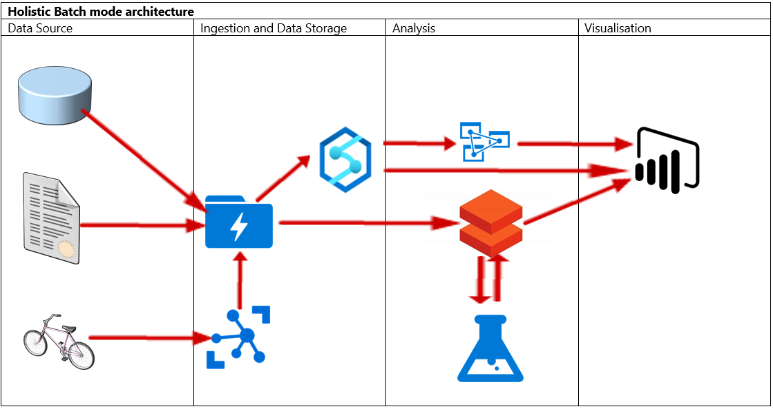
Lab review
Exercise 1 - Task 2: Build a high-level Architecture that reflects the Enterprise BI solution in Adv. Works

Slide 21
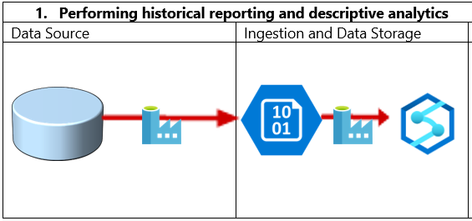
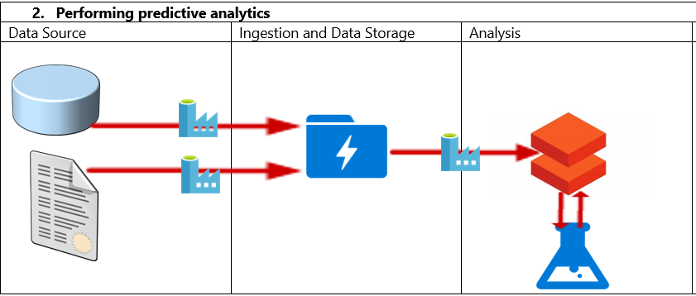
Lab review
Exercise 2 - Amend a high-level architecture to include automation of an Enterprise BI solution in AW

Slide 22
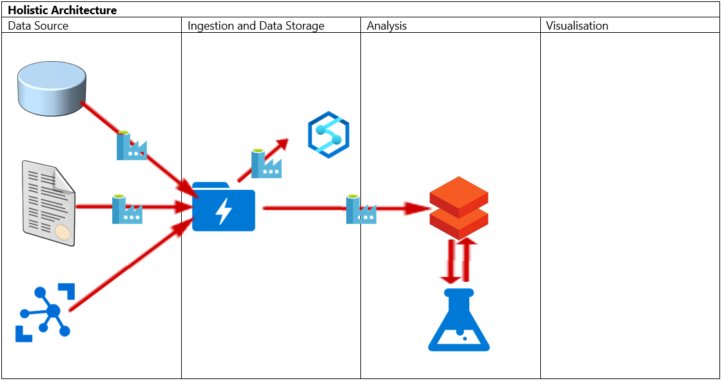
Lab review
Exercise 2 - Amend a high-level architecture to include automation of an Enterprise BI solution in AW

Slide 23
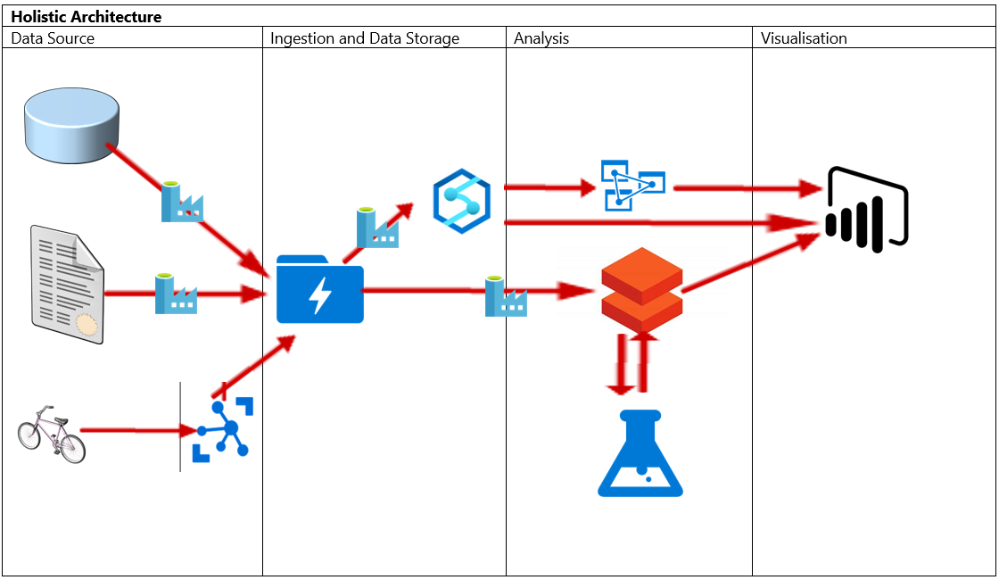
Lab review
Exercise 2 - Amend a high-level architecture to include automation of an Enterprise BI solution in AW

Slide 24
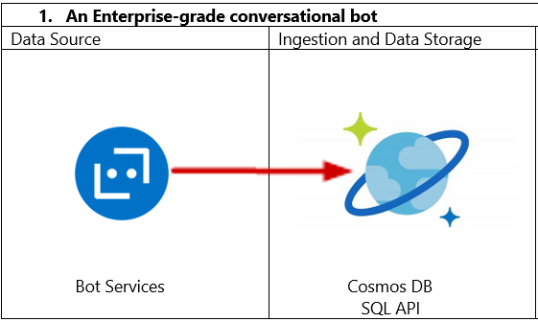
Lab review
Exercise 3 - Task 1: Architect an Enterprise-grade conversational bot in Azure.

Slide 25

Next steps
Module Summary
In this module, you have learned about:
- Lambda architectures from a batch mode perspective
- Design an enterprise business intelligence solution
- Automate an enterprise business intelligence solution
- Architect an enterprise conversational bot
After the course, consider visiting the Azure Reference Architecture site to view a wide range of architectures that can be implemented based on scenario.

